Slide 1
Bing Ads Ad Extensions and Annotations Features

Slide 2
Overview
What Are Ad Extensions?
Why Ad Extensions?
Types of Ad Extensions
Location Extension
Call Extension
Sitelink Extension
Enhanced Sitelink Extension
Callout Extension
Review Extension
Image Extension
Offer Extension
Action Link Extension
Video Extension
Ad Annotations
Types of Ad Annotation
Consumer Sentiment Annotation
Twitter Annotation
Merchant Rating Annotation
Smart Annotation
Notes:
These are UK figures only but a good starting point to understanding how the rest of EMEA operates
Source: xAd/Telemetrics by Nielsen
http://www.emarketer.com/Article/Apps-Most-Popular-UK-Mobile-Search/1009572

Slide 3
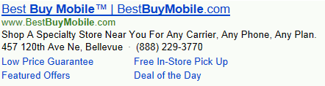
What Are Ad Extensions?
Ad Extensions make ads more relevant and informative by adding supplementary information to the Ad Copy
There are 3 main types of Ad Extensions available in BingAds :
Local Extensions
Call Extensions
Sitelink Extensions
Advertisers can adopt Ad Extensions at Ad group, Campaign or Account level
Adoption of Ad extensions at Account level was enabled by Bing recently (Announcement made on 19th September, 2017)
Extensions set at the ad group or campaign level will trump those set at the account levels
Location Extension
Call Extension
Sitelink Extension
Notes:
These are UK figures only but a good starting point to understanding how the rest of EMEA operates
Source: xAd/Telemetrics by Nielsen
http://www.emarketer.com/Article/Apps-Most-Popular-UK-Mobile-Search/1009572

Slide 4

Why Use Ad Extensions?
End users spend 5+ hours on internet each day across variety of devices
It is now essential for every business to have a search strategy and extensions give ads more prominence and get more clicks
PC
Mobile
Tablet
Average of 321.6 minutes per day spent on both laptops PC
Average of 59.4 minutes per day spent on mobile (data subscribers)
Average of 20 minutes per day spent on tablets
>90% of consumers search online for local businesses
50% of smartphones & tablet users expected locations to be within driving distance
Notes:
These are UK figures only but a good starting point to understanding how the rest of EMEA operates
Source: xAd/Telemetrics by Nielsen
http://www.emarketer.com/Article/Apps-Most-Popular-UK-Mobile-Search/1009572

Slide 5
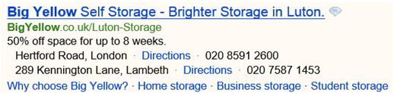
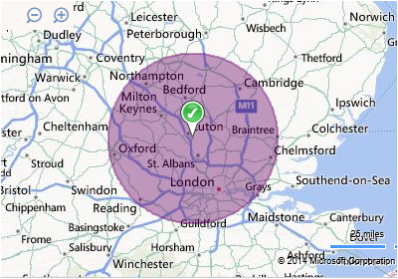
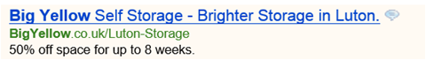
Location Extensions – Include Address & Directions Within Ads
Locations extensions overview
Location Extensions enable advertisers to include their business address, phone number, and a link with directions in their ad copy
When the ad is clicked, a Bing Maps page will be automatically rendered showing the related address
Examples :
Notes:
When advertisers enable Location Extensions, they can choose to
show the address of their business location that is closest to the customer
and also include a local phone number.
This means that your ads can go from looking like this (click) To this…(click)
The radius for the location display is 50 miles (or 80 kilometres). If the advertiser does not have a business location entered that is within 50 miles (80 kilometres) of the customer, no address will be shown in the ad.
If there are multiple locations, Location Extensions will show the nearest business location within 50 miles (80 kilometres) or the value selected for Radius Targeting.
Note that you do not need to use Radius Targeting to use the Location Extensions feature.
Business addresses can be displayed without a phone number, but phone numbers cannot be displayed on their own.

Slide 6
Why Use Location Extensions?
3 out of 4 mobile and 2 out of 3 PC / tablet searches result in a purchase by customers coming into brick-and-mortar stores¹
67% Of smartphone users and 72% of PC / tablet users want ads customized with a location extension, such as an address, city or zip code²
The added extensions don’t cost extra money to serve and can increase click through rates
Extensions provide advertisers more real estate (space) in search result pages, and help ads stand out and look more credible
Advertisers have complete control on location targeting around specific business addresses
1. comScore, Neustar Localeze, and 15 Miles. "Trends Shaping Local Search in 2014." 2. Ipsos MediaCT, Purchased and Google. "Understanding Consumer’s Local Search Behavior," 2014.
Notes:
Location Extensions are not going to be suitable for all advertisers. However, they do provide a competitive advantage for advertisers when used correctly
When you have a location-specific offering
Any advertiser that has multiple brick and mortar locations can benefit from Location extensions. Chain restaurants, retail stores etc.
Great for mobile searchers as they are usually looking on the go
To make ads more actionable and increase leads
Adding extensions gives you more ways to interact with your customers and provides a strong call to action
To improve overall CTR
During testing of this feature it was found that rather than use the phone number provided, searchers tended to click these ads more often as they found the ads to be more relevant, leading to better performance
33% higher CTR on average for searches with local intent vs. ads without location targeting in US tests (Figures from testing period)

Slide 7
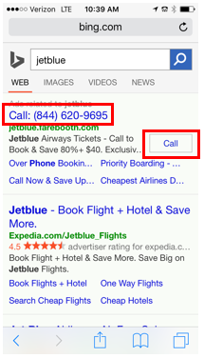
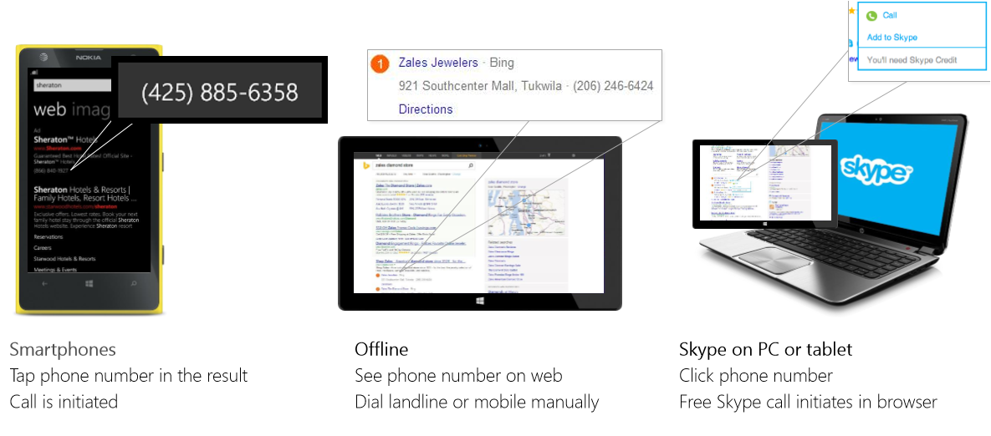
Call Extensions – Add Phone Number to Enable Calling
Call Extensions enable advertisers to display phone number, as well as a click-to-call button, within their ad copy
Bing Call Extensions come in two flavors:
Display on ALL devices: Enable advertisers track calls and attain in-depth performance metrics (call type, duration, etc.) for all Pay-Per-Click (PPC) generated phone calls. To do this, dynamic forwarding numbers is created to appear in ads
Display on Smartphones only: With this option, advertisers phone numbers appear in the click-to-call format. Clicks to this line are reported, however no in-depth call details are tracked
Example :
Notes:
Advertisers can include a phone number in their ads on any device — including PCs, tablets, and smartphones — to drive new leads. They can also access reports that provide detailed call analytics, such as call duration and missed calls, on all calls their ads have generated. Advertisers in these markets have the option to either display Call Extensions on all devices or smartphones only.
The Location Extensions feature is used to provide an address and local phone number associated with a local location. Using Call Extensions, you can provide a phone number that is not associated with a particular location, but is appropriate for all locations where your ads display.
Clicking on the phone number link will initiate a call to that number, and you will be charged up to your bid amount (just as if the user had clicked on a website link).
Only one Call Extension is supported per campaign.
You can have both location extensions and call extensions enabled on your campaign

Slide 8
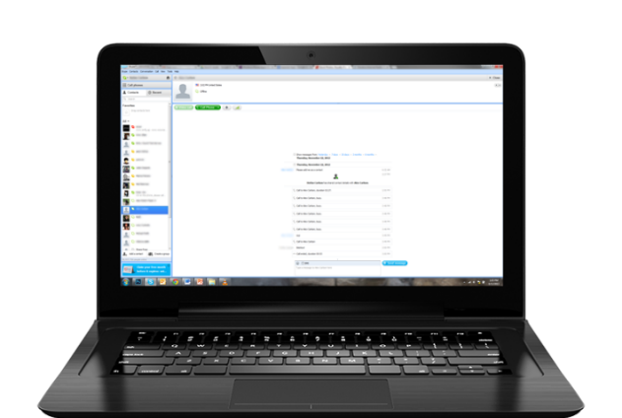
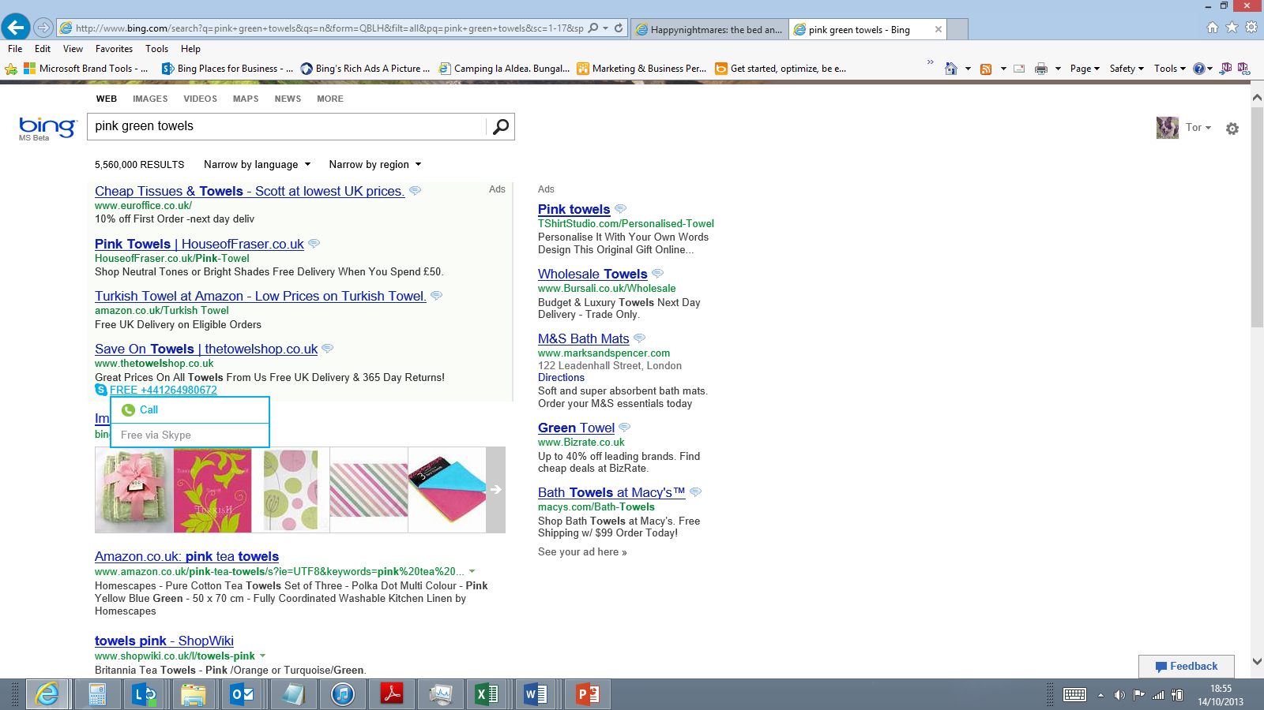
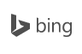
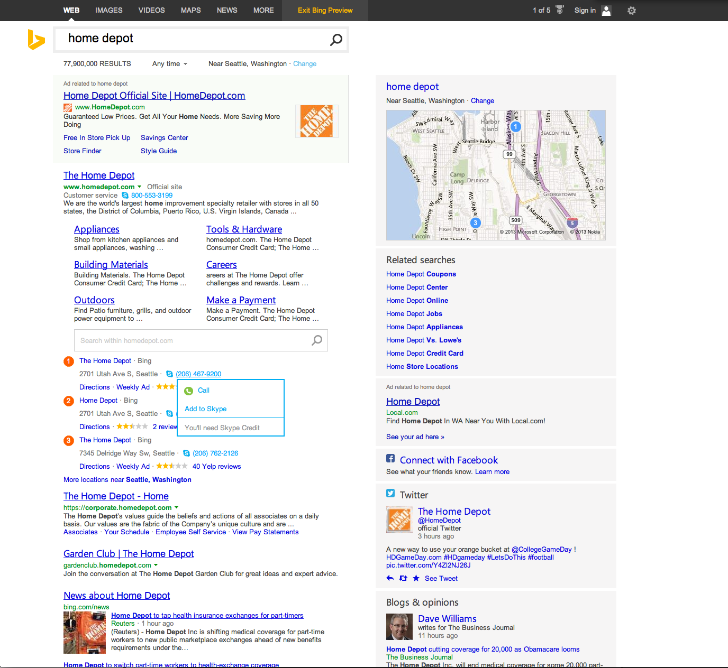
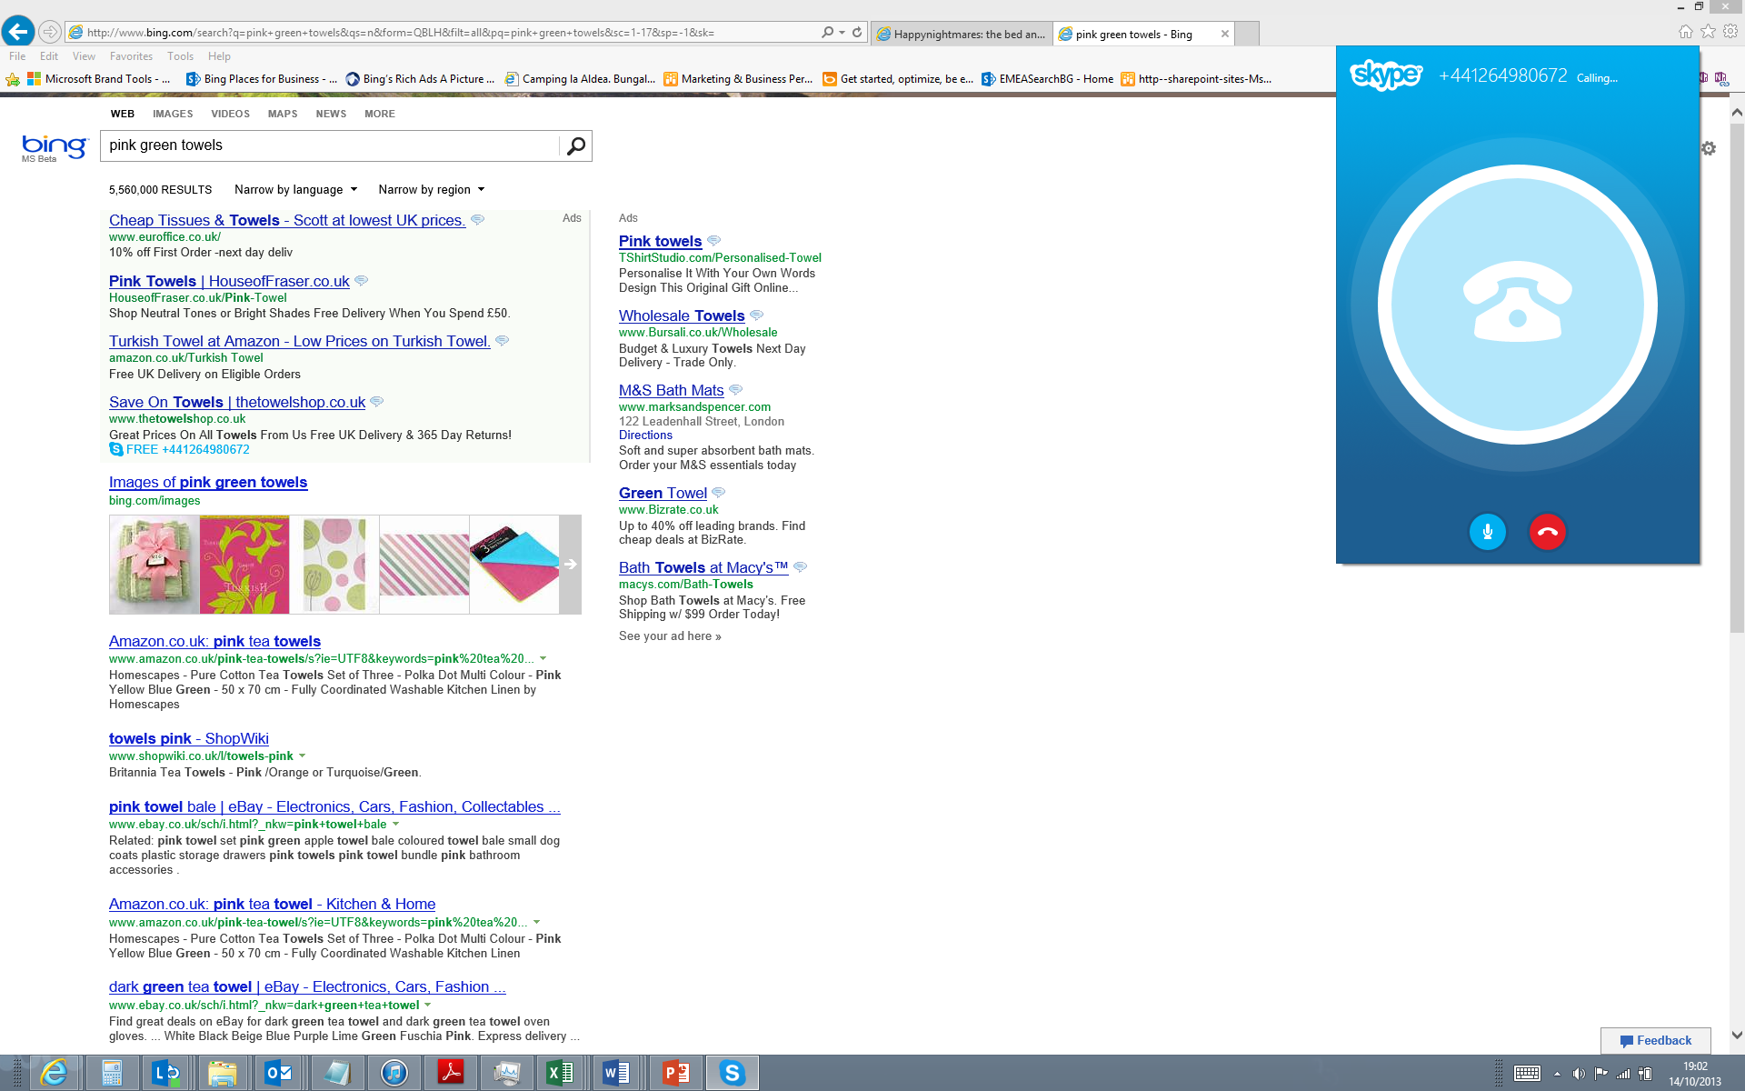
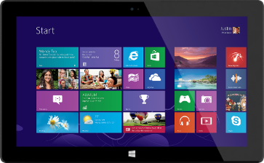
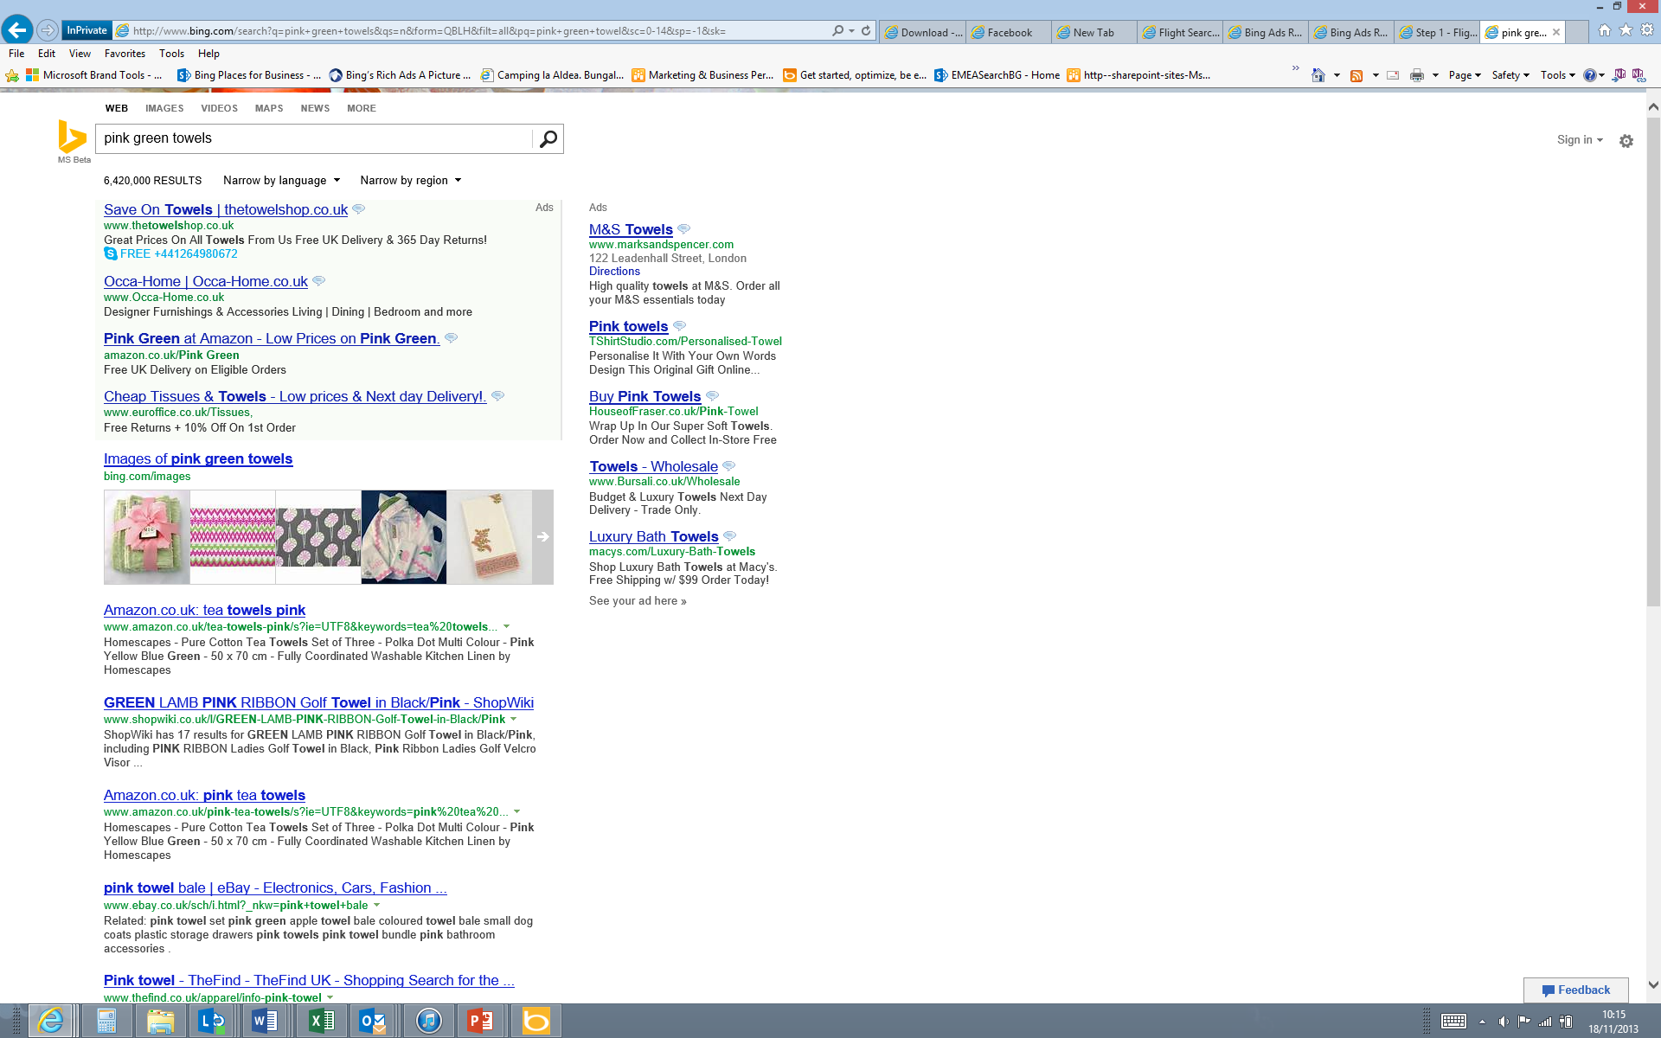
Call Extensions – In-Browser Calling
Bing is the world’s first search engine with in-browser calling
It allows end users to call the number given in the Call Extension just by clicking it
Example :
Notes:
Call Extensions – in browser calling
Enable calls to be connected directly through smartphones
Skype enabled connected calls through a browser
Call metered forwarding numbers, and full call tracking
Click to call charged as a click, when initiated from the ad
Google doesn’t offer this feature

Slide 9
Why Use Call Extensions?
Users can easily contact advertisers with questions
To improve overall conversions – calls convert X 10 times better than clicks
Additional¹ reporting available including call duration and missed calls (US / UK)
Bing Ads with Call Extensions generated 3%-6% more clicks, on average, than those without Call Extensions²
1. Specific tracking and analytics to meter a range of call and campaign details — call type, duration and area code
2. Internal Microsoft Data, July 2015.
Notes:
Searchers can easily contact you with questions
Valuable for local campaigns and campaigns where mobile impressions are likely
24 hour emergency plumber – searcher can call with one click
Advertisers can create call-only ads
To improve overall CTR
To improve overall conversions – calls converts X10 better than clicks
Better reporting on searcher intent - Advertisers can track call duration and missed calls

Slide 10
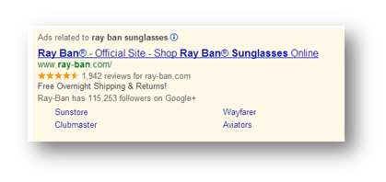
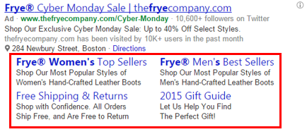
Sitelink Extensions – Add Multiple Deep-Links To Ads
Sitelink extensions allow advertisers to include multiple deep links within their ads, taking searchers directly to the information they are looking for
Advertiser can even elect to enhance the Sitelinks by adding two lines of descriptive text along with each link (desktop only)
Example :
Notes:
Sitelink extensions are additional text+URL pairs that provide links to an advertiser’s website and can be associated with a text ad campaign of the advertiser. These links provide more specific access points into the advertiser’s website to drive searchers to exactly the information they are looking to find, which can increase CTR.
This means that your ads can go from looking like this (click) To this…
With Sitelink Extensions, advertisers can enter up to 10 Sitelink Extensions and display up to 6 in their mainline text ads (4 for mobile campaigns). Display options include:
Four links on one line
Three links on one line
Four links on two lines
Six links on three lines (PC/tablet campaigns only)

Slide 11
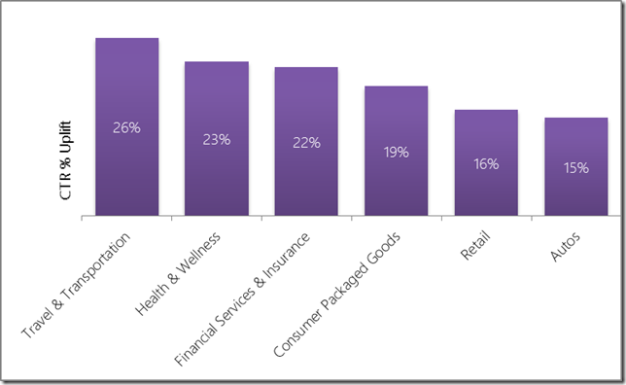
Why Use Sitelink Extensions?
To improve Click Through Rate (CTR) by up to 25%*
To improve visibility for advertisers with multiple product types
To improve visibility for brand keywords
To improve overall conversions
To provide better reporting on user’s intent
Break down the statistics by campaign, ad group to see the number of clicks that occurred on the individual sitelink versus another part of the ad (e.g., the headline, other sitelinks, or another extension).
*Internal Microsoft Data 2015
Notes:
Sitelink extensions are all about determining searcher intentions
For advertisers with multiple product groups
Advertisers that have various departments within their account structure can send advertisers to the correct section of their site
For brand keywords
Site link extensions are especially good for brand keywords when the searcher’s intention is not clear
For example, a bank could have such sitelinks as – mortgages, loans, insurance or bank accounts
To improve overall CTR
Providing sitelinks gives the searcher more of a reason to click on your ad as it provides extra space for advertisers to call out the products or services it provides
To improve overall conversions
Site links can bring searchers closer to the product or service they are interested in
The closer you can drop a searcher to their desired content, the more likely they are to buy and not click back
Better reporting on searcher behaviours
Allows advertisers to get a better idea of what specific areas searchers are looking for when they search on their brand and generic keywords
We can see user intention. For example if a searcher searches on a bank’s brand name and then chooses loans, we know what their intention was when searching originally
We can then use this information to target these areas in ad copy or keywords
You can pull reports to see what sitelinks are getting clicked

Slide 12
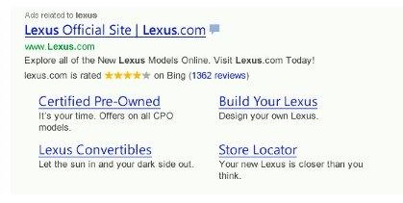
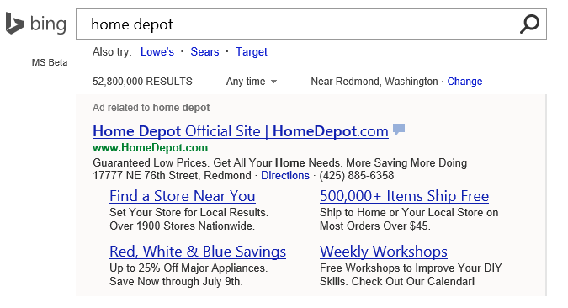
Enhanced Site Links (ESL) – Add Descriptive Text To Sitelinks
Enables advertisers to add 2 lines of descriptive text ( up to 70 total characters) to site links
Makes ads bigger and bolder and matching organic search results which help attract users attention
ESL extensions are triggered when an ad is at ML1 and ad quality is very high. The number of enhanced site links served depends on ad quality and relevance of the site links
Examples :
Up to 2 lines of additional content
Increased size and prominence of the Sitelinks headline

Slide 13
Why Use Enhanced Site Link (ESL) Extensions?
To achieve higher Click Through Rates (CTR)
On average, the click through rate is estimated to be 15% higher for ads with Sitelinks than those without
Just like in AdWords, advertisers will be able to add two additional lines of text with each site link in ad extension

Slide 14
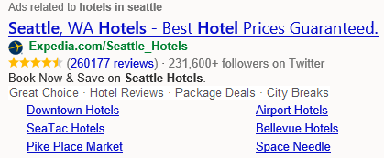
Callout Extension – Enhance Ads With Key Selling Products
Callout Extensions allow advertiser to emphasize up to 4 related products’ key selling points below the ad
Unlike Sitelinks, these snippets are not clickable links; they solely enable adding more text to an ad copy
Each Campaign / Ad Group can have up to 20 associated Callout extensions
Callout extensions can be shown on PC / tablet, and mobile devices
Advertisers can import their callout extensions campaigns from AdWords into Bing Ads
Example :
*Include additional screenshot mocks as necessary following this slide.

Slide 15
Why Use Callout Extensions?
To provide ability to highlight the leading features of an advertiser’s offer
To increase advertiser’s share of screen space with an additional line in ad, which could increase click through rate.
Can be combined with other extensions to boost customer engagement
*Include additional screenshot mocks as necessary following this slide.

Slide 16
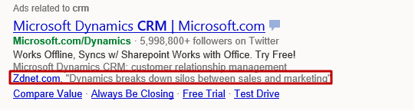
Review Extension – Display a Third-Party Business Review
Review Extensions enable advertisers to include a third-party endorsement of their business below an ad
The review must be from a reputable source, rather than a personal customer review and must be a reflection of the business as a whole
Reviews can be either paraphrased or an exact quote from the source
Each Campaign / Ad Group can have 1 Review Extension associated with it
Review extensions are rendered on PC / tablet, and mobile devices
Advertisers are able to import review extensions campaigns from AdWords into Bing Ads
Example :
*Include additional screenshot mocks as necessary following this slide.

Slide 17
Why Use Review Extensions?
To provide ability to create an extension that highlights positive third-party reviews within an ad
Reviews are super valuable to newer or smaller businesses whose brands are not widely known
To build a sense of trust using a third-party endorsement
*Include additional screenshot mocks as necessary following this slide.

Slide 18
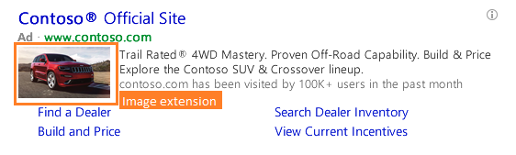
Image Extensions – Add Visual Element To Ads
Image Extensions enable advertisers to upload an image to appear alongside an ad copy
Works with other extensions within ads for more calls to action and increased clicks
Render on PC and tablet search results pages across Bing O&O sites
Up to six images can be associated with each campaign or ad group
Bing Ads can serve only one image per ad, and will rotate between all uploaded images
Limit of 1,000 campaigns and ad groups combined that can have Image Extensions
Image Extensions can be used for any keyword. Keywords must be relevant to the images and ad copy. Keywords can include brand, product and category terms
Recommended: Provide a URL to be associated with each image. If not provided, clicking an image will be directed to the ad’s landing page
Example :

Slide 19
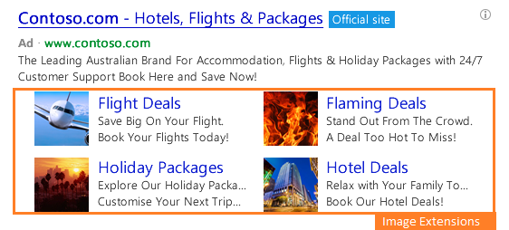
Image Extension – Associated Text
Advertisers are expected to submit customer-ready display text and descriptions for each Image Extension, as both of these may show as part of ad in future versions of the extension
Display Text (required)
Length: 18 characters
Description (optional)
Highly recommended
Length: 40 characters
Example :
Display Text
Required. Length: 18
characters.
Description
Recommended. Length:
40 characters.

Slide 20
Why Use Image Extensions?
To get more relevant traffic to customers web sites by showing searchers up front what to expect when they click on an ad
To draw attention by taking up more real estate in the search results and stay competitive with a larger ad footprints
*Include additional screenshot mocks as necessary following this slide.

Slide 21
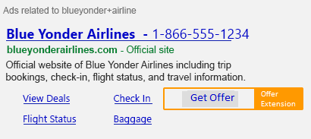
Offer Extensions – Add Time Sensitive Deals
Offer Extensions enable advertisers to present relevant offers within their ad text to drive higher click through rates
When users click the “view offer” link, they are transferred to a Bing hosted landing page that provides an option to print out the offer or “save it for later.” These extensions give clients an extra incentive to visit stores and complete a transaction
Example :
Notes:
35 character

Slide 22
Why Use Offer Extensions?
To drive users interest for exclusive time sensitive deals and offers
To increase the size of ads and increase click through rates
*Include additional screenshot mocks as necessary following this slide.

Slide 23
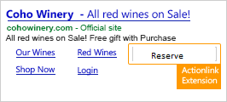
Action Link Extensions – Deeplink to Highest Converting Pages
Action Link Extensions enable advertisers to add a call-to-action button right within an ad
With a different color background from the rest of the ad, the call-to-action button stands out and captures users attention
Example :
Increased Prominence within Ad Copy
Link directly to your highest converting web page
Notes:
35 character

Slide 24
Why Use Action Link Extensions?
To increase click through rate
There are no CPC premiums as CPCs are consistent with clicks on the headline
Links to advertiser’s landing page where users can take action
*Include additional screenshot mocks as necessary following this slide.

Slide 25
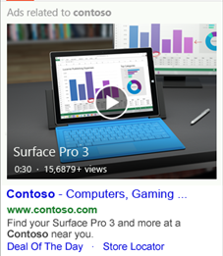
Video Extensions – Add Enriching Content
Video Extensions enable advertisers to enrich their ad copies by adding video links
Can be served together with other extensions
Example :

Slide 26
Why Use Video Extensions?
To enhance end user experience
To increase ad size and click through rates
Notes:
35 character

Slide 27
Ad Annotations
Annotations are used to make ad copies more attractive and informative
Advertisers can’t adopt the annotations similar to adopting extensions. However, can block annotations for their ads through opt-out settings in Bing Ads UI
All advertisers are eligible for ad annotations, however, annotations are not always guaranteed to show in their ads

Slide 28
Consumer Sentiment Annotation – Add Customer Review Text
Description
This annotation shows the most representative consumer review text with positive sentiment about the advertiser in their ad copy. This informs users what other consumers like about a particular advertiser resulting in increased user confidence, thus increasing click through rates
Benefits
Ads CTR uplift by increasing user confidence in ads and advertisers
How it Works
Step 1: The original reviews comes from existing reviews already used for Merchant Rating annotation, which is obtained from 3rd party review site
Step 2: Select candidate reviews with high rating
Step 3: Cluster reviews by topics (for example, delivery, customer service, pricing, etc)
Step 4: Choose the representative topic and representative reviews in it
Step 5: Ad domain matches records from step 4
Step 6: Ad domain matches thresholds requirements based on marketplace optimization
Step 7: Ad meets required quality or revenue thresholds which will be based on marketplace optimization
*Include additional screenshot mocks as necessary following this slide.

Slide 29
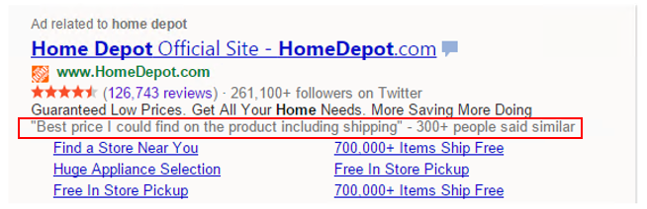
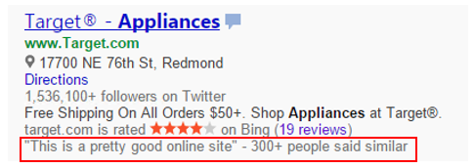
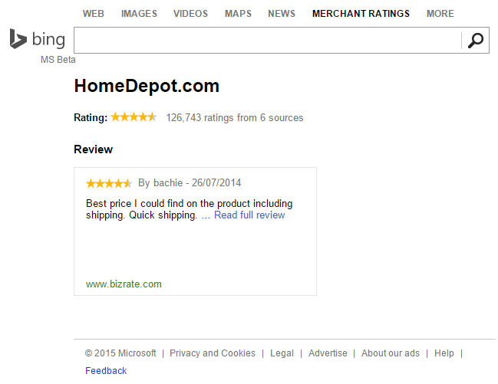
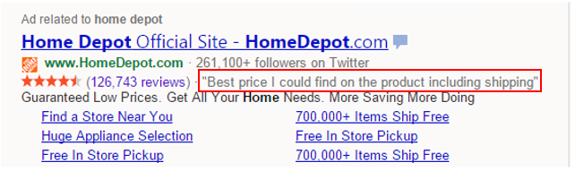
Consumer Sentiment - Example
Experience on Bing
Mainline on separate line
On side bar
Grey links point user to the attribution page
(the design may change during implementation)
Mainline on fact row with MR
*Include additional screenshot mocks as necessary following this slide.

Slide 30
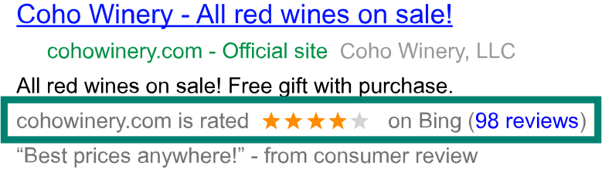
Merchant Rating Annotation – Add Third Party Reviews
Description
Displays customer’s business rating and links to highly rated reviews to show what people are saying about the related business.
Benefits
Reviews and ratings primarily reflect customers' overall consumer experience
Eligibility Requirements
Step 1: The campaign should be set up as either a Search and content campaign (US only) or Search campaign (non-US only)
Step 2: In most cases, advertisers’ business must have at least 30 unique reviews, each from the past 12 months -- and a composite rating of at least 3.5 stars or higher
Step 3: However, Bing Ads may show ratings for merchants with fewer than 30 reviews if they have sufficient data from other sources to determine an accurate rating
Example:
User search for “Coho Winery”. A Coho Winery
Ad is served that includes rating
(starting with “cohowinery.com is rated”).

Slide 31
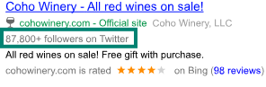
Twitter Annotation – Displays Number of Followers
Description
Displays number of followers on Twitter. This can increase interest in the related advertiser’s ad
How it works
Bing Ads verifies if the domain of the customer’s final destination URL matches one of Bing's top domains or websites and if it has social information available
Example
User searches for “Coho Winery”. A Coho Winery
Ad is served that includes number of followers on Twitter
*Include additional screenshot mocks as necessary following this slide.

Slide 32
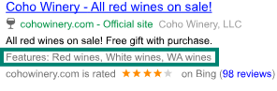
Smart Annotation – Add Information from Landing Page
Description
Smart annotations highlight specific products and brands that are featured on an advertiser’s website. This helps to inform users of the variety of products and services offered by the related advertiser’s website
How it works
Bing Ads scans the landing page of advertisers’ website to identify product categories, features, or brand names that match the content of the search terms. It can also leverage the landing page title
Example
User searches for “Coho Winery”. A Coho Winery
Ad is served that includes specific products and brands
*Include additional screenshot mocks as necessary following this slide.

